Slide 1
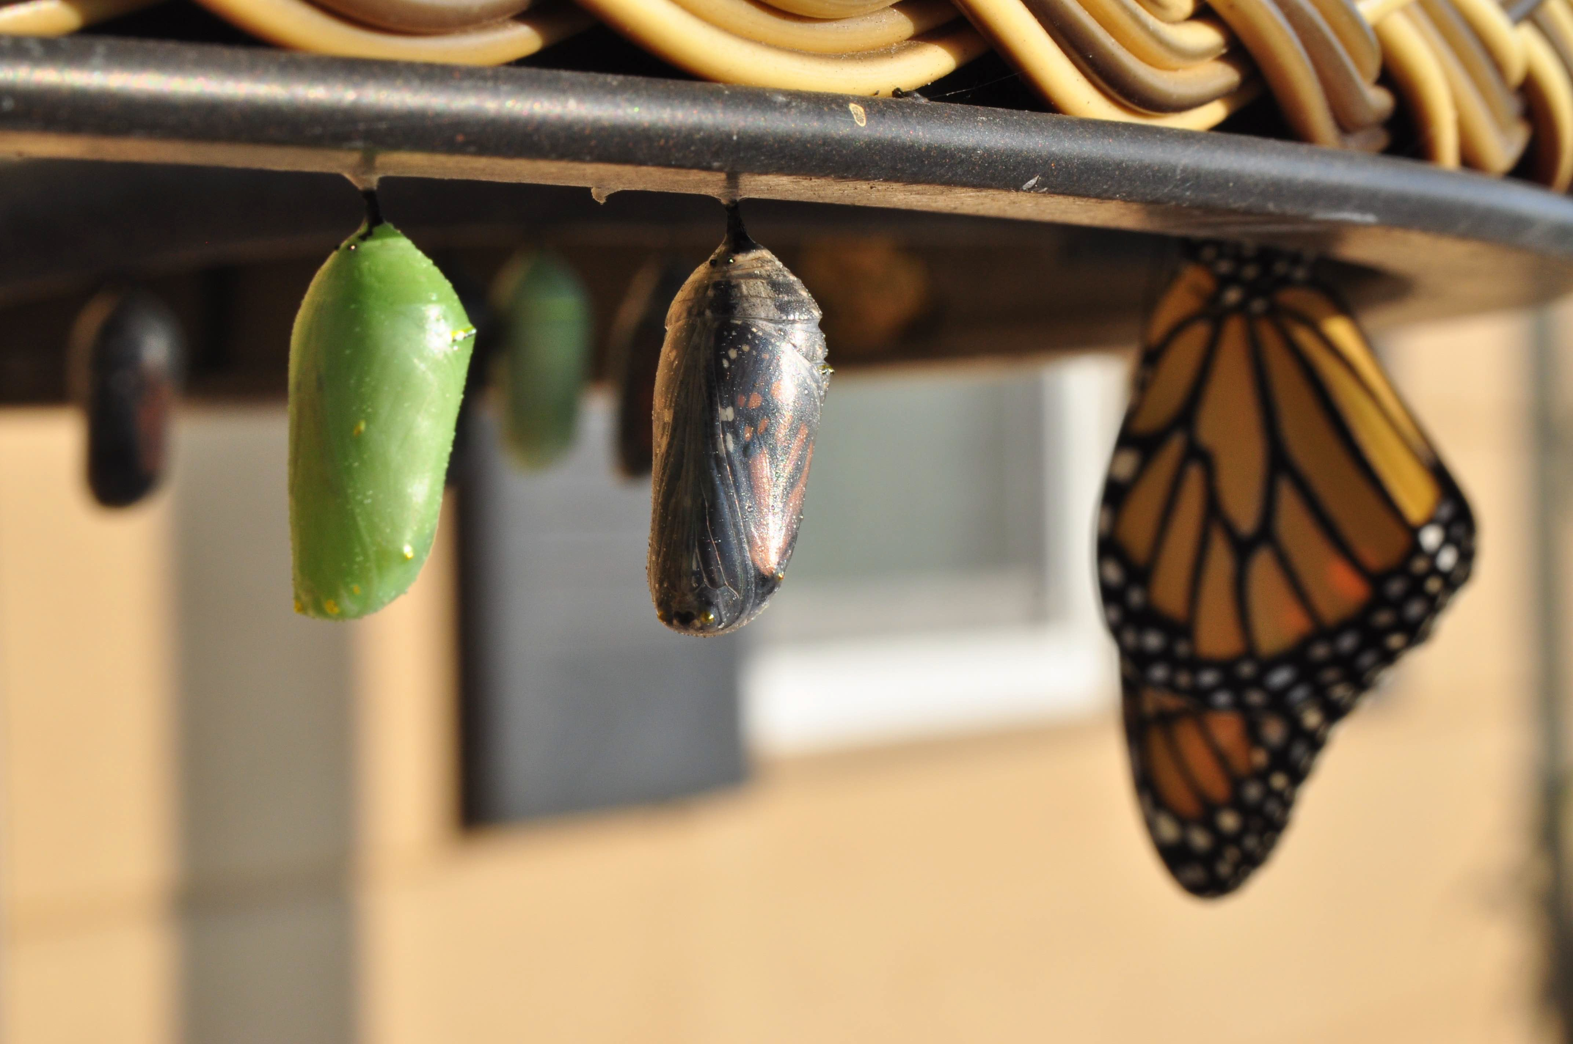
Introduction to Modern Controls
Z transform
Z Transform

Slide 2
The Z transform approach to Ordinary difference Equations (OdEs)
Z Transform
OdE
Algebraic equation
Easy
?
Easy
Arithmetic
Easy
OdE solution
Algebraic solution
Inverse Z Transform
analogous to Laplace transform for continuous-time signals
Z Transform

Slide 3
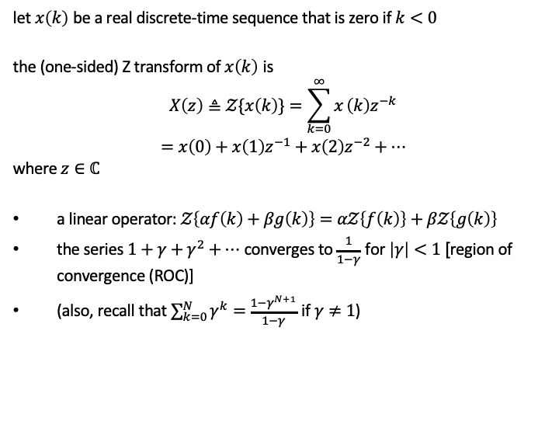
Definition
let $x\left(k\right)$ be a real discrete-time sequence that is zero if $k<0$
the (one-sided) Z transform of $x\left(k\right)$ is
$$\begin{matrix} & X\left(z\right)≜𝒵\{x\left(k\right)\}=\sum_{k=0}^{∞}{x}\left(k\right)z^{−k} \\ & =x\left(0\right)+x\left(1\right)z^{−1}+x\left(2\right)z^{−2}+…\end{matrix}$$
where $z∈ℂ$
a linear operator: $𝒵\left\{αf\left(k\right)+βg\left(k\right)\right\}=α𝒵\left\{f\left(k\right)\right\}+β𝒵\left\{g\left(k\right)\right\}$
the series $1+γ+γ^{2}+…$ converges to $\frac{1}{1−γ}$ for $\left|γ\right|<1$ [region of convergence (ROC)]
(also, recall that $\sum_{k=0}^{N}{γ^{k}}=\frac{1−γ^{N+1}}{1−γ}$ if $γ≠1$)
Z Transform

Slide 4

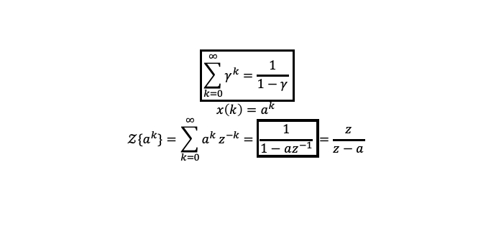
Example: geometric sequence $\{a^{k}\}_{k=0}^{∞}$
$$\boxed{\sum_{k=0}^{∞}{γ^{k}}=\frac{1}{1−γ}}$$
$$x\left(k\right)=a^{k}$$
$$𝒵\{a^{k}\}=\sum_{k=0}^{∞}{a^{k}}z^{−k}=\boxed{\frac{1}{1−az^{−1}}}=\frac{z}{z−a}$$
Z Transform

Slide 5
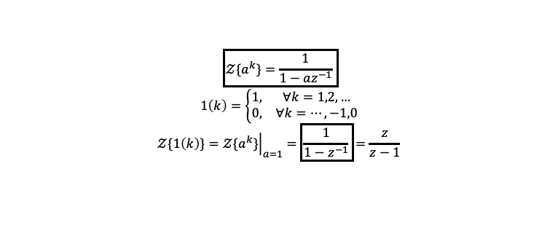
Example: step sequence (discrete-time unit step function)
$$\boxed{𝒵\{a^{k}\}=\frac{1}{1−az^{−1}}}$$
$$1\left(k\right)=\left\{\begin{matrix}1, & ∀k=1,2,… \\ 0, & ∀k=…,−1,0\end{matrix}\right.$$
$$𝒵\{1\left(k\right)\}={\left.𝒵\{a^{k}\}\right|}_{a=1}=\boxed{\frac{1}{1−z^{−1}}}=\frac{z}{z−1}$$
Z Transform

Slide 6

Example: discrete-time impulse
1, k = 0
0, otherwise
δ(k) =
$$𝒵\{δ\left(k\right)\}=1$$
Z Transform

Slide 7
Exercise: cos(ω₀k)
Z Transform

Slide 8
f(k)
F(z)
ROC
δ(k)
a^{k}1 (k)
−a^{k}1(−k −1)
ka^{k}1 (k)
All z
1
1
|z|>|a|
1 − az⁻¹
1
|z|<|a|
1 − az⁻¹
_{az}−1
(1 − az⁻¹)²
|z|>|a|
_{az}−1
(1 − az⁻¹)²
k
|z|<|a|
−ka 1(−k −1)
cos(ω₀k) sin(ω₀k)
1 − z⁻¹ cos(ω₀)
|z|>1
1 − 2z⁻¹ cos(ω₀) + z⁻²
z⁻¹ sin(ω₀)
|z|>1
1 − 2z⁻¹ cos(ω₀) + z⁻²
_{a}k
_{a}k
1 − az⁻¹ cos(ω₀)
cos(ω₀k)
sin(ω₀k)
|z|>|a|
1 − 2az⁻¹ cos(ω₀) + a²z⁻²
az⁻¹ sin(ω₀)
1 − 2az⁻¹ cos(ω₀) + a²z⁻²
|z|>|a|
Z Transform
8 / 19

Slide 9
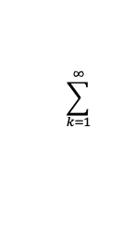
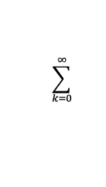
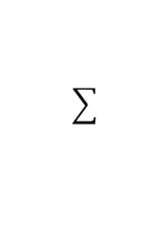
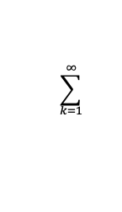
Properties of Z transform: time shift
let Z{x(k)} = X(z) and x(k) = 0 ∀k < 0 one-step delay:
$$\sum_{k=0}^{∞}{ }$$
$$\sum_{k=1}^{∞}{ }$$
Z{x(k − 1)} = x
−k
−k
(k − 1)z = x
(k − 1
)z + x
(−1)
$$\sum_{k=1}^{∞}{ }$$
= x(k − 1)z
−(k−1) −1
z + x(−1)
= z⁻¹X(z) +x(−1) =
z⁻¹X(z)
∞
analogously, Z{x(k + 1)} =
x(k + 1)z^{−k}
= zX(z) − zx(0)
k=0
thus, if x(k + 1) = Ax(k) + Bu(k) and x(0) = 0,
zX(z) = AX(z) + BU(z) ⇒ X(z) = (zI − A)⁻¹BU(z)
provided that (zI − A) is invertible
Z Transform
8 / 19

Slide 10
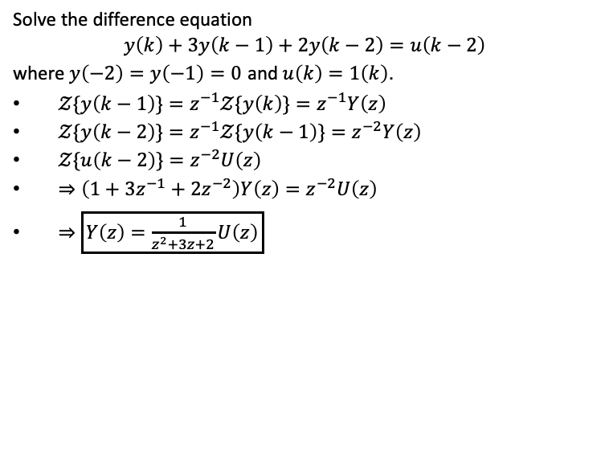
Solving difference equations
Solve the difference equation
$$y\left(k\right)+3y\left(k−1\right)+2y\left(k−2\right)=u\left(k−2\right)$$
where $y\left(−2\right)=y\left(−1\right)=0$ and $u\left(k\right)=1\left(k\right)$.
$𝒵\{y\left(k−1\right)\}=z^{−1}𝒵\{y\left(k\right)\}=z^{−1}Y\left(z\right)$
$𝒵\{y\left(k−2\right)\}=z^{−1}𝒵\{y\left(k−1\right)\}=z^{−2}Y\left(z\right)$
$𝒵\{u\left(k−2\right)\}=z^{−2}U\left(z\right)$
$⇒\left(1+3z^{−1}+2z^{−2}\right)Y\left(z\right)=z^{−2}U\left(z\right)$
$⇒\boxed{Y\left(z\right)=\frac{1}{z^{2}+3z+2}U\left(z\right)}$
Z Transform

Slide 11
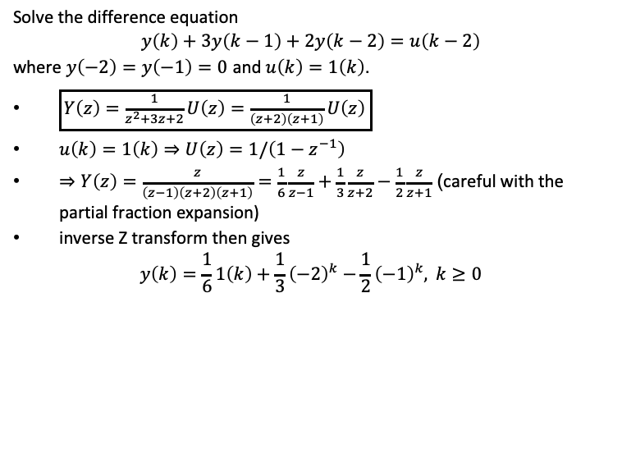
Solving difference equations
Solve the difference equation
$$y\left(k\right)+3y\left(k−1\right)+2y\left(k−2\right)=u\left(k−2\right)$$
where $y\left(−2\right)=y\left(−1\right)=0$ and $u\left(k\right)=1\left(k\right)$.
$\boxed{Y\left(z\right)=\frac{1}{z^{2}+3z+2}U\left(z\right)=\frac{1}{\left(z+2\right)\left(z+1\right)}U\left(z\right)}$
$u\left(k\right)=1\left(k\right)⇒U\left(z\right)=1/\left(1−z^{−1}\right)$
$⇒Y\left(z\right)=\frac{z}{\left(z−1\right)\left(z+2\right)\left(z+1\right)}=\frac{1}{6}\frac{z}{z−1}+\frac{1}{3}\frac{z}{z+2}−\frac{1}{2}\frac{z}{z+1}$ (careful with the partial fraction expansion)
inverse Z transform then gives
$$y\left(k\right)=\frac{1}{6}1\left(k\right)+\frac{1}{3}{\left(−2\right)}^{k}−\frac{1}{2}{\left(−1\right)}^{k}, k≥0$$
Z Transform

Slide 12
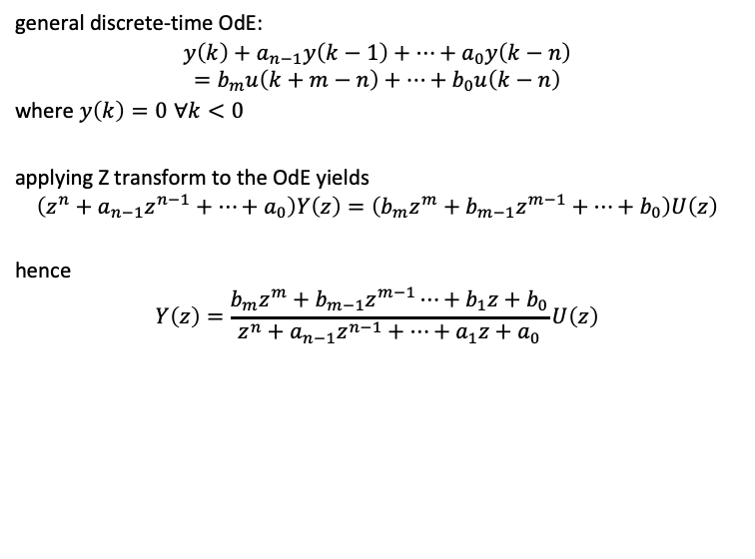

From difference equation to transfer functions
general discrete-time OdE:
$$y\left(k\right)+a_{n−1}y\left(k−1\right)+…+a_{0}y\left(k−n\right)=b_{m}u\left(k+m−n\right)+…+b_{0}u\left(k−n\right)$$
where $y\left(k\right)=0$ $∀k<0$
applying Z transform to the OdE yields
$$\left(z^{n}+a_{n−1}z^{n−1}+…+a_{0}\right)Y\left(z\right)=\left(b_{m}z^{m}+b_{m−1}z^{m−1}+…+b_{0}\right)U\left(z\right)$$
hence
$$Y\left(z\right)=\frac{b_{m}z^{m}+b_{m−1}z^{m−1}⋯+b_{1}z+b_{0}}{z^{n}+a_{n−1}z^{n−1}+⋯+a_{1}z+a_{0}}U\left(z\right)$$
$$G_{yu}\left(z\right): \text{discrete}\text{−}\text{time} \text{transfer} \text{function}$$
Z Transform

Slide 13
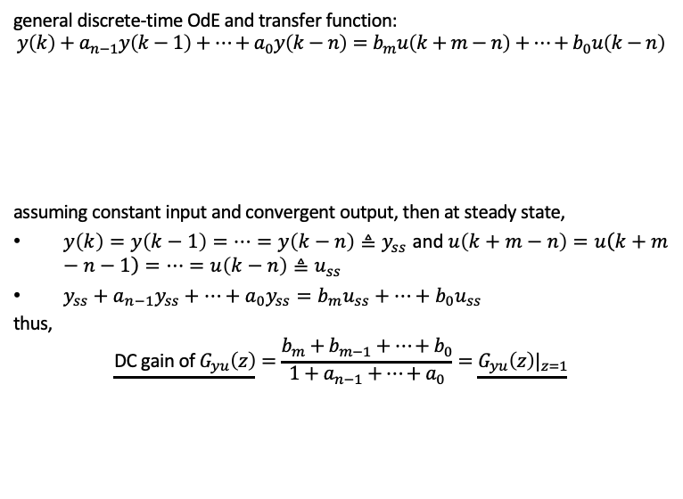

DC gain of discrete-time transfer functions
general discrete-time OdE and transfer function:
$$y\left(k\right)+a_{n−1}y\left(k−1\right)+…+a_{0}y\left(k−n\right)=b_{m}u\left(k+m−n\right)+…+b_{0}u\left(k−n\right)$$
assuming constant input and convergent output, then at steady state,
$y\left(k\right)=y\left(k−1\right)=…=y\left(k−n\right)≜y_{ss}$ and $u\left(k+m−n\right)=u\left(k+m−n−1\right)=…=u\left(k−n\right)≜u_{ss}$
$y_{ss}+a_{n−1}y_{ss}+…+a_{0}y_{ss}=b_{m}u_{ss}+…+b_{0}u_{ss}$
thus,
$$\underline{\text{DC} \text{gain} \text{of} G_{yu}\left(z\right)}=\frac{b_{m}+b_{m−1}+…+b_{0}}{1+a_{n−1}+…+a_{0}}=\underline{G_{yu}\left(z\right)|_{z=1}}$$
$$Y\left(z\right)=\frac{b_{m}z^{m}+b_{m−1}z^{m−1}⋯+b_{1}z+b_{0}}{z^{n}+a_{n−1}z^{n−1}+⋯+a_{1}z+a_{0}}U\left(z\right)$$
$$G_{yu}\left(z\right): \text{discrete}\text{−}\text{time} \text{transfer} \text{function}$$
Z Transform

Slide 14
Transfer functions in two domains
y(k) + an−1y(k − 1) + · · · + a0y(k − n) = bmu(k + m − n) + · · · + b0u(k − n)
B(z)
bmz^{m} + bm−1z^{m−1} · · · + b1z + b0
Gyu(z) = _{A(z)} =
z + a z + · · · + a z + a
v.s.
d^{n}y(t) dt^{n}
n n−1
n−1 1 0
d^{n−1}y(t) _{dt}n−1
d^{m}u(t)
d^{m−1}u(t)
+ an−1
+ · · · + a0y(t) = bm
dt^{m}
+ bm−1
_{dt}m−1
+ · · · + b0u(t)
B(s)
bms^{m} + · · · + b1s + b0
Gyu(s) = =
A(s) s + a s + · · · + a s + a
n
n−1
n−1 1 0
Properties
Gyu(s)
Gyu(z)
poles and zeros
roots of A(s) and B(s)
roots of A(z) and B(z)
causality condition
n ≥ m
n ≥ m
DC gain / steady-state response to unit step
Gyu(0)
Gyu(1)
Z Transform

Slide 15
Coding a discrete-time transfer function
num = [0.09952, -0.08144];
den = [1, -1.792, 0.8187];
Ts = 0.1;
sys_tf = tf(num,den,Ts) poles = pole(sys_tf); zeros = zero(sys_tf);
disp(['System Poles = ',num2str(poles')]) disp(['System Zeros = ',num2str(zeros')])
[yout, T] = step(sys_tf); figure, stairs(T, yout) figure, impulse(sys_tf)
u1 = 2*ones(length(T),1); u2 = sin(T);
figure, lsim(sys_tf,u1,T) figure, lsim(sys_tf,u2,T)
Z Transform

Slide 16
import control as co
import matplotlib.pyplot as plt import numpy as np
Ts = 0.1 # sampling time
num = [0.09952, -0.08144] # Numerator co-efficients den = [1, -1.792, 0.8187] # Denominator co-efficients sys_tf = co.tf(num,den, Ts)
print(sys_tf)
poles = co.pole(sys_tf) zeros = co.zero(sys_tf)
print('\nSystem Poles = ', poles, '\nSystem Zeros = ', zeros)
T,yout = co.step_response(sys_tf) plt.figure(1,figsize = (6,4)) plt.step(T,np.append(0,yout[0:-1])) plt.grid(True)
plt.ylabel("y")
plt.xlabel("Time (sec)")
plt.show()
Z Transform

Slide 17
import control as co
import matplotlib.pyplot as plt import numpy as np
Ts = 0.1 # sampling time
num = [0.09952, -0.08144] # Numerator co-efficients den = [1, -1.792, 0.8187] # Denominator co-efficients sys_tf = co.tf(num,den, Ts)
print(sys_tf)
poles = co.pole(sys_tf) zeros = co.zero(sys_tf)
print('\nSystem Poles = ', poles, '\nSystem Zeros = ', zeros)
T,yout_i = co.impulse_response(sys_tf) plt.figure(1,figsize = (6,4)) plt.step(T,np.append(0,yout_i[0:-1])) plt.grid(True)
plt.ylabel("y")
plt.xlabel("Time (sec)") plt.show()
Z Transform

Slide 18
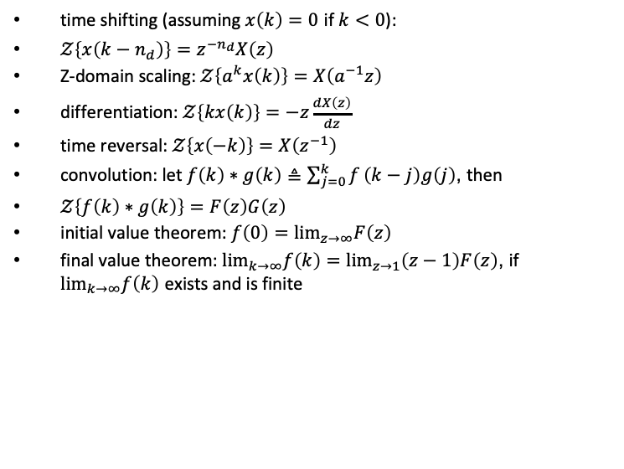
Additional useful properties of Z transform
time shifting (assuming $x\left(k\right)=0$ if $k<0$):
$𝒵\left\{x\left(k−n_{d}\right)\right\}=z^{−n_{d}}X\left(z\right)$
Z-domain scaling: $𝒵\left\{a^{k}x\left(k\right)\right\}=X\left(a^{−1}z\right)$
differentiation: $𝒵\left\{kx\left(k\right)\right\}=−z\frac{dX\left(z\right)}{dz}$
time reversal: $𝒵\left\{x\left(−k\right)\right\}=X\left(z^{−1}\right)$
convolution: let $f\left(k\right)∗g\left(k\right)≜\sum_{j=0}^{k}{f}\left(k−j\right)g\left(j\right)$, then
$𝒵\left\{f\left(k\right)∗g\left(k\right)\right\}=F\left(z\right)G\left(z\right)$
initial value theorem: $f\left(0\right)=\lim_{z→∞}F\left(z\right)$
final value theorem: $\lim_{k→∞}f\left(k\right)=\lim_{z→1}\left(z−1\right)F\left(z\right)$, if $\lim_{k→∞}f\left(k\right)$ exists and is finite
Z Transform

Slide 19
Mortgage payment
image you borrow $100,000 (e.g., for a mortgage) annual percent rate: APR = 4.0%
plan to pay off in 30 years with fixed monthly payments interest computed monthly
what is your monthly payment?
Z Transform

Slide 20
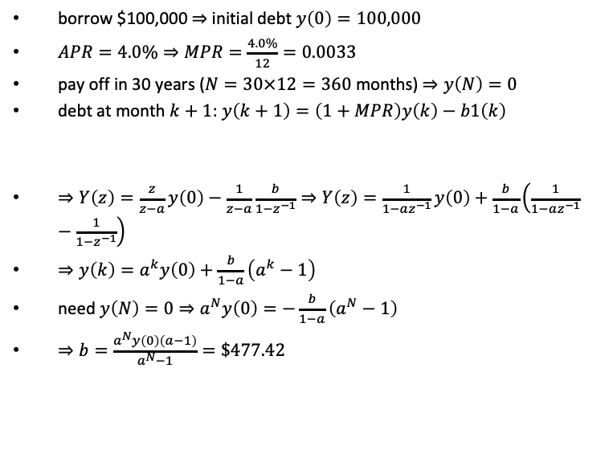

Mortgage payment
borrow $100,000 $⇒$ initial debt $y\left(0\right)=100,000$
$APR=4.0\%$ $⇒$ $MPR=\frac{4.0\%}{12}=0.0033$
pay off in 30 years ($N=30×12=360$ months) $⇒y\left(N\right)=0$
debt at month $k+1$: $y\left(k+1\right)=\left(1+MPR\right)y\left(k\right)−b1\left(k\right)$
$⇒Y\left(z\right)=\frac{z}{z−a}y\left(0\right)−\frac{1}{z−a}\frac{b}{1−z^{−1}}$ $⇒Y\left(z\right)=\frac{1}{1−az^{−1}}y\left(0\right)+\frac{b}{1−a}\left(\frac{1}{1−az^{−1}}−\frac{1}{1−z^{−1}}\right)$
$⇒y\left(k\right)=a^{k}y\left(0\right)+\frac{b}{1−a}\left(a^{k}−1\right)$
need $y\left(N\right)=0⇒a^{N}y\left(0\right)=−\frac{b}{1−a}\left(a^{N}−1\right)$
$⇒b=\frac{a^{N}y\left(0\right)\left(a−1\right)}{a^{N}−1}=\$477.42$
$$a$$
monthly pay
Z Transform

